Slide 1
Your project and how it would be completed: what I can do for you!
Created By Billy Robinson

Slide 2
Your company
“Thumb-busters” are a local company who have six different highstreet shops across the region. You specialise in retro computer gaming, but are looking to expand and branch out into different areas of computer gaming related activities.
You have released a set of problems that you’d like someone to help you overcome, I believe that this is within my scope and as a result: I have created a pitch to show you my previous experience within these areas.

Slide 3
Your website
The first problem you have is that you would like your website updating.
Some facts:
It hasn’t been updated since 2005
lots of information is out of date
it doesn’t work on mobile devices.
You would like a brand new website where customers can search their second hand stock for product prices and also search for “trade-in” prices. You are not yet interested in selling products online.

Slide 4
Your website: building a new one
In order to create a modern website, I’d use HTML 5, CSS, Javascript and PHP. This allows the website to function both server-side and client-side. The website would need to follow typical website conventions (e.g. having a head, body and footer) and have a menu system to allow people to navigate between the pages.
In addition: I’d add CSS into your website: thus allowing me to style it to suit your needs and fit your company’s current branding. As your website hasn’t been updated since 2005, it’d need a fresh lick of paint to bring it up to the web’s current modern design and feel.
Finally: as you haven’t got much web presence currently: It’d be a great idea to start looking into SEO in order to improve visibility on search websites such as google, this is something that I’m confident in and can offer assistance.

Slide 5
Your website: mobile compatibility
In order to add mobile compatibility to your website: your website needs to implement responsive web design – this allows information to be the same, but sizes and styling to change dynamically.
We will use media queries to perform this task: This allows us to set specific CSS rules for different device widths and means we can remove useless styling that wouldn’t make sense to have on a mobile device.

Slide 6
Your website: searching for stock
In order for your website to live up to modern standards: it’ll need to allow people to search for your stock before they even arrive in store: meaning customers know if you have something: without having to come in and ask you!
This means creating an SQL database, placing all of the products into this database and using SELECT statements to pull information, so that it can be presented to the customer. The following information would be given:
Second hand price
Trade in prices
This also means that the information can be updated from other sources as prices shift.

Slide 7
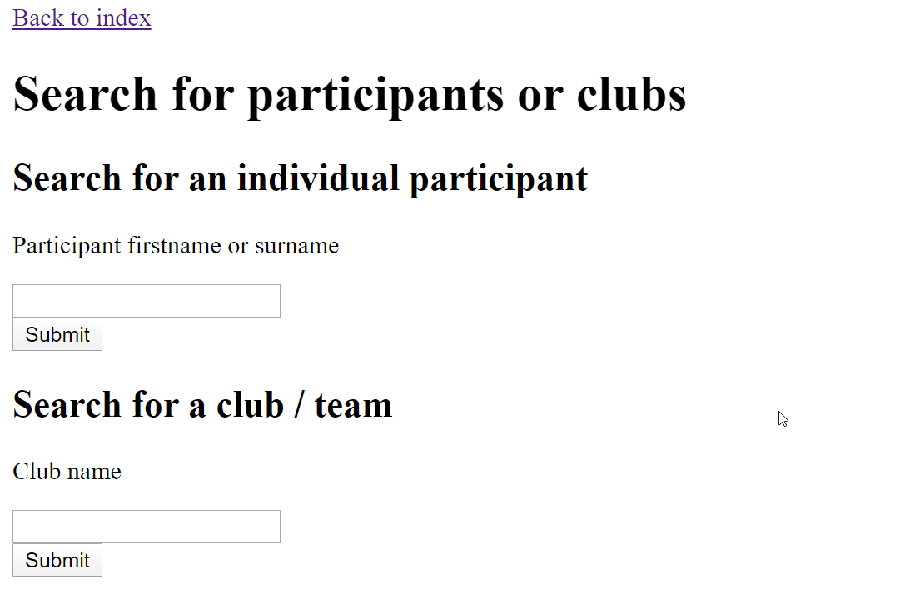
Example of me doing this previously
My previous experience working with SQL allows me to be a perfect fit for this task as I’ve previously been involved with the CIT-E cycling project: which asked for me to implement and design a database which required a search system
This means I’ve had the previous experience of creating similar systems which allow for easy updating and allow for customers using search functionality.
I’ve also had some experience with a donut project: which required creating a mobile friendly version of the website using media queries. This means that I’m your perfect fit when it comes to implementing similar CSS solutions for your systems.

Slide 8
Lan Parties
The second problem you have is that you want to host LAN parties inside of your stores. However, you currently have no hardware.
You are looking to put 30 gaming PCs into each store and network them together locally.
You also want each store to be able to compete against each other on a larger network for larger tournaments.

Slide 9
Lan Parties: Building hardware
In order to provide a reasonable solution that’s able to run games but also keeps cost down, especially over lots of units: we must build a system to suit this.
This means, splashing out a bit on things like the graphics card and processor, however being a bit less flashy with things like computer cases, chairs, desks and other equipment that isn’t essential to running a game. Unless your budget provides for such expenses.
I highly recommend going for Intel for this specific project as they’re powerful: and allow for programs to run on multiple threads, meaning the load can be balanced between each of the cores and utalize intel’s high multi core power – unlike other manufacturers, intel focuses on multi-core power.

Slide 10
Lan Parties: Connecting hardware
In order to network all of the computers together: we’d need a switch to connect to all of the computers. This would allow us to run local instances of the game and play together.
If these games are internet required: we’d need to add a Hub onto the network that connects to an ISP. This would allow us to have internet connection: in order to do this, we would also have to take into account the speed of the service provider and ensure that it meets our needs and requirements.
In order to create a larger network with multiple stores: we’d have to treat each store as a subnet (a network within a network). This would allow us to create a system which allows for interactivity between the stores as they’re technically on the same network.

Slide 11
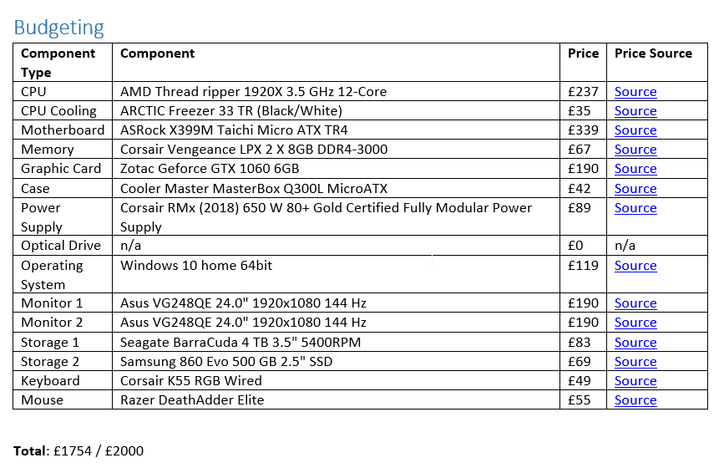
Example of me doing this previously
Previously: I’ve built a system for the CIT-E cycling project which asked me to provide specifications for a gaming computer as a competition reward: this means that I’ve had experience designing similar systems to the systems that you’re requesting.
This allows me to come in and setup your computing systems: meaning I’d be able to do the work requested. I’d also be able to come in and setup a network design as well as have the capability of setting up a physical network from experience both in virtual environments such as packet tracer: as well as team work from previous projects in setting up physical equipment.

Slide 12
Till system
You need a system where stock can be catalogued and itemised as it comes into each store. This system would also need to double up as a till for the sale of your products.
This could simply be done using windows forms, which allows us to create easy to use forms: that could be used by employees in order to input data and save that data to a database: allowing us to display information on the website (mentioned earlier).

Slide 13
Till system: cataloguing and itemising stock
In order to do this: we would need an input form that allows employees to input the number of each product in a list: this would be done through the database we discussed earlier as a background storage system. We would input the data through a windows form solution: which would be created in C#.
The form would be extremely easy to use for employees: allowing them to click a button to add another stock, click a button to remove a stock and also allow them to enter a number of available stock. Allowing for a variety of different counting methods.
Data entered into this system could then be used for sales on the website: as we enter prices into this system, it’d allow prices to be shown on the website and used within a till system to determine the total value of anything that a customer selects.

Slide 14
Till system: sale of products
In order to allow the system to double up as a till system, we would need a multi-form project that allows you to switch between modes: we would need to have prices supplied by employees: or by managers and then counted by employees. Once a price is set, we could then go about calculating the total basket cost per transaction.
Once someone purchases something: we could easily remove 1 item from the available items: thus meaning it instantly updates on the online website. Meaning customers who are watching things online would be aware of how many of a specific game/item are remaining.
This till system could very easily allow for debit card payments by a customer: it’d just require another form to be added to the project and an API to be implemented that allows for us to charge customers cards.

Slide 15
Till system: database design
In order to make an efficient system: we would need to take into account the design of the database. This would allow us to create a database which uses the information required only once, meaning less space is taken within the database.
In order to do this: we would use database normalization: normalizing to the 3rd level. This means that no data is repeated within the database and makes it easier to handle the information without creating duplicate records.

Slide 16
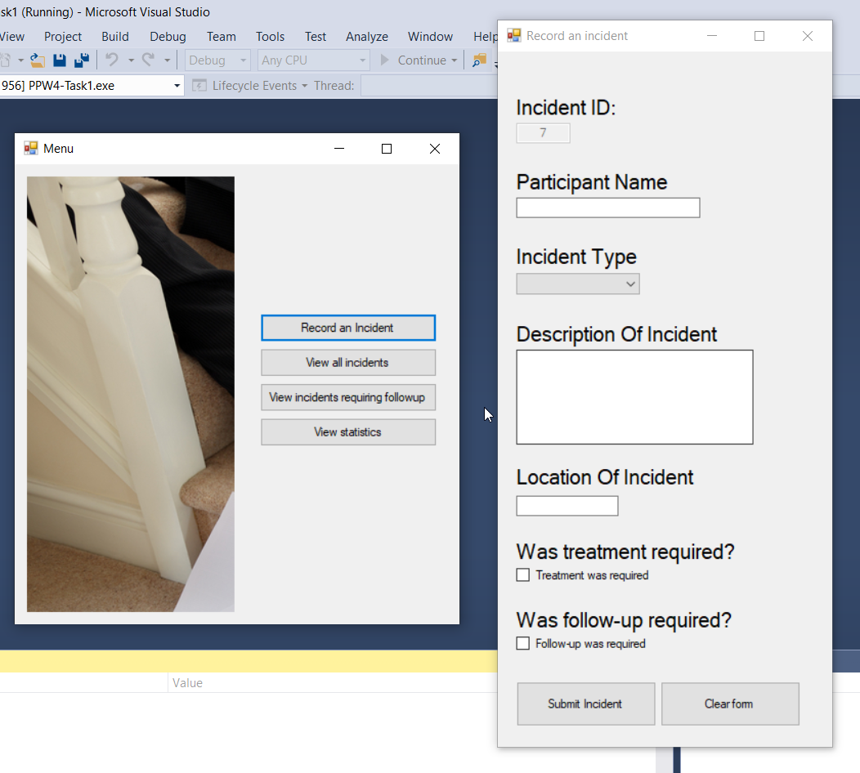
Example of me doing this previously
Previously: I have created windows forms solutions that allow people to do multiple things: recently I have created a multi-form project for the CIT-E cycling event that allowed me to develop a system in which: people could report accidents.
I have experience within data storage systems (such as MySQL and MongoDB) that would allow me to design and write the code to store information provided from employees (stock taking) and then use this to charge the customer the appropriate amount.

